Slide 1
Capstone Project – IBM Coursera Clustering Neighborhoods of Bangalore, IN based on Venue Information
Jayadev K A – 2020

Slide 2
Introduction
Business Problem: World over entrepreneurs face various challenges in setting up a viable business. This study tries to serve as an guide to help entrepreneurs tackle:
Understand the best location to setup business.
Understand customer needs & preferences by location.
Understand the best business idea based on cluster relationship.
Target Audience:
Entrepreneurs/Business Owners
Fast food chain company’s

Slide 3
Data Description
Data Source:
Bangalore Location Data : https://finkode.com/ka/bangalore.html
Bangalore Venue Data: https://foursquare.com/
Data Pre-Processing
Data Scraping
Beautiful Soup library to scrape Bangalore location data
Geopy to get Latitude & Longitude information
Foursquare API
Scrape venue information based on lat/long information scraped
Remove locations with less than 10 venues.
Data Frame creation
Create final data frame structure for clustering.
Gather the top 10 venue for each location. Using Mean method.
Remove locations with incorrect geo-locations

Slide 4
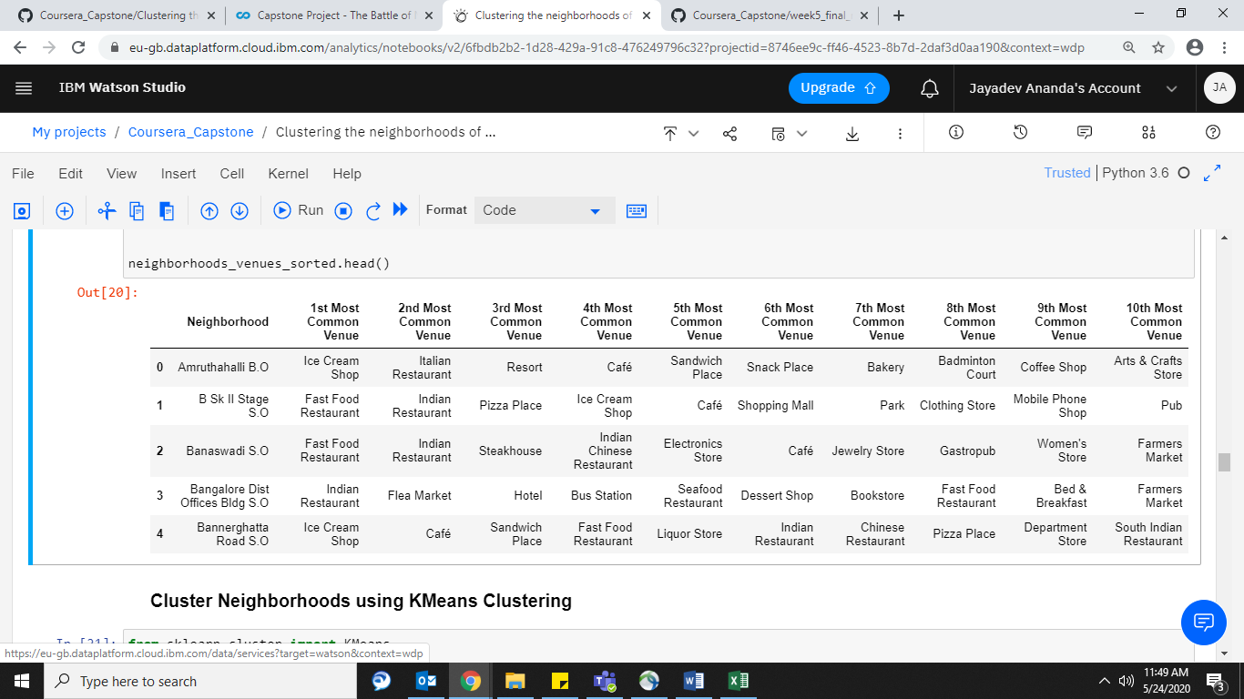

Slide 5
Methodology
Clustering
K-Means clustering to classify the geo-locations based on the top 10 Venue information.
Optimal K Value
Using the elbow method (sum of squared distance) it was determined that 2 cluster would be the optimal to classify the given data.
K- Means clustering technique was selected
The major principle behind the algorithm is large distance of separation between observations in inter-clusters and small distance of separation between observations in intra-clusters

Slide 6
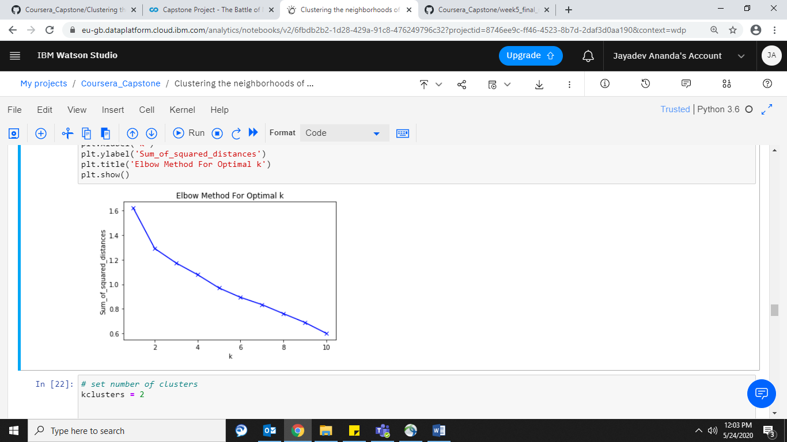

Slide 7
Results
The results from the K-Means cluster with K selected as 2, yields the following observations:
Cluster 0
Cluster 1
These neighborhoods are characterized by high number of
Ice-cream Shops,
Café & Tea Rooms,
Hotels and Resorts,
Pub’s, Vegan and Italian Restaurants,
Fast Food Joins,
Clothing stores &
Farmers Market.
Cluster 0 comprises of neighborhoods like
Amruthahalli, Bannerghatta Road, Chickpet, CMP Centre and School, Electronics City, H.A.L II tage, Hoodi, Indiranagar,, Jayanagar, Malleswaram , Nagarbhavi ,Seshadripuram ,Sivan Chetty Gardens.
These neighborhoods are characterized by high number of
Indian, Seafood and Chinese Restaurants,
Departmental stores,
Electronic stores,
Jewelry stores &
Gym’s.
Cluster 0 comprises of neighborhoods like
Banaswadi, Basavanagudi, Basaveshwaranagar, C.V.Raman Nagar, Chikkalasandra, Domlur, Immedihalli, Koramangala VI Bk, Mahalakshmipuram Layout.

Slide 8
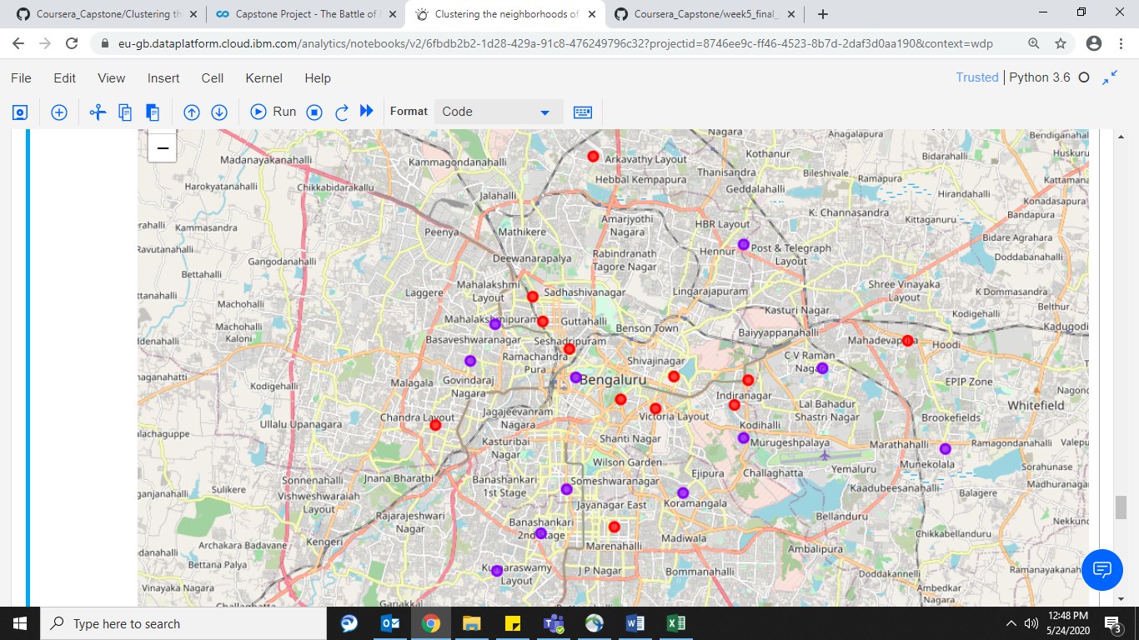
The two clusters have been visualized in the map below, cluster 0 is represented in “Red” and cluster 1 has been represented in “Violet”

Slide 9
Discussion
The results of this study provides a backdrop of current business concentration in various major locations throughout Bangalore.
Based on Venue information
Cluster 0 comprises of venues attracting younger population
Cluster 1 comprises of venues attracting older & family oriented customers.
Study also helps Entrepreneurs in deciding the right business ideas that will succeed for a given location based on the clustering. Similar, clusters represent similar characteristics.

Slide 10
Limitations & Suggestions
The current data set seems to be limited with venue information available only from Foursquare.com.
Data does not comprise of the overall venue information in Bangalore
Future studies should gather information from Google, Swiggy & Zomato for extensive data on local businesses

Slide 11
Conclusion
The study successfully classified the various locations into two categories
Cluster 0 comprised of businesses catering hip & current trends.
While Cluster 1 comprised of basic & routine business supporting older population and family oriented sections.
Using this as a reference
Business owners can pin point the right locations based on their business ideas
Scope out the right business ideas based on the need currently not being catered to.

Slide 12


